Slide 1
Building ML Solutions with AWS AI Services

Slide 2
Introduction to AI Services
What are AI Services? Fully managed services with pre-trained models to perform specific ML tasks (e.g., sentiment analysis, object detection).
Primary Users: Application developers building AI-enabled applications without needing ML expertise.
Key Benefits: Fast time-to-market, reduced need for ML data and engineering, scalability, and cost-effectiveness.
Limitations: Limited customization; pre-set algorithms with restricted access to underlying models.

Slide 3
Overview of AWS AI Services
AWS AI Service Categories: NLP, computer vision, industrial AI, and recommendation services.
Example Services: Amazon Comprehend (NLP), Textract (OCR), Rekognition (Image Analysis), Transcribe (Speech-to-Text).
Goal: Provide essential tools for common business use cases across various industries.

Slide 4
Amazon Comprehend – NLP Service
Entity Recognition: Identifies names, places, dates, and other entities; useful for document indexing.
Sentiment Analysis: Detects positive, negative, or neutral sentiments, valuable for customer insights.
Topic Modeling: Groups related documents based on topics; aids in organizing large text datasets.
Language Detection & Syntax Analysis: Detects primary language and part-of-speech tags.

Slide 5
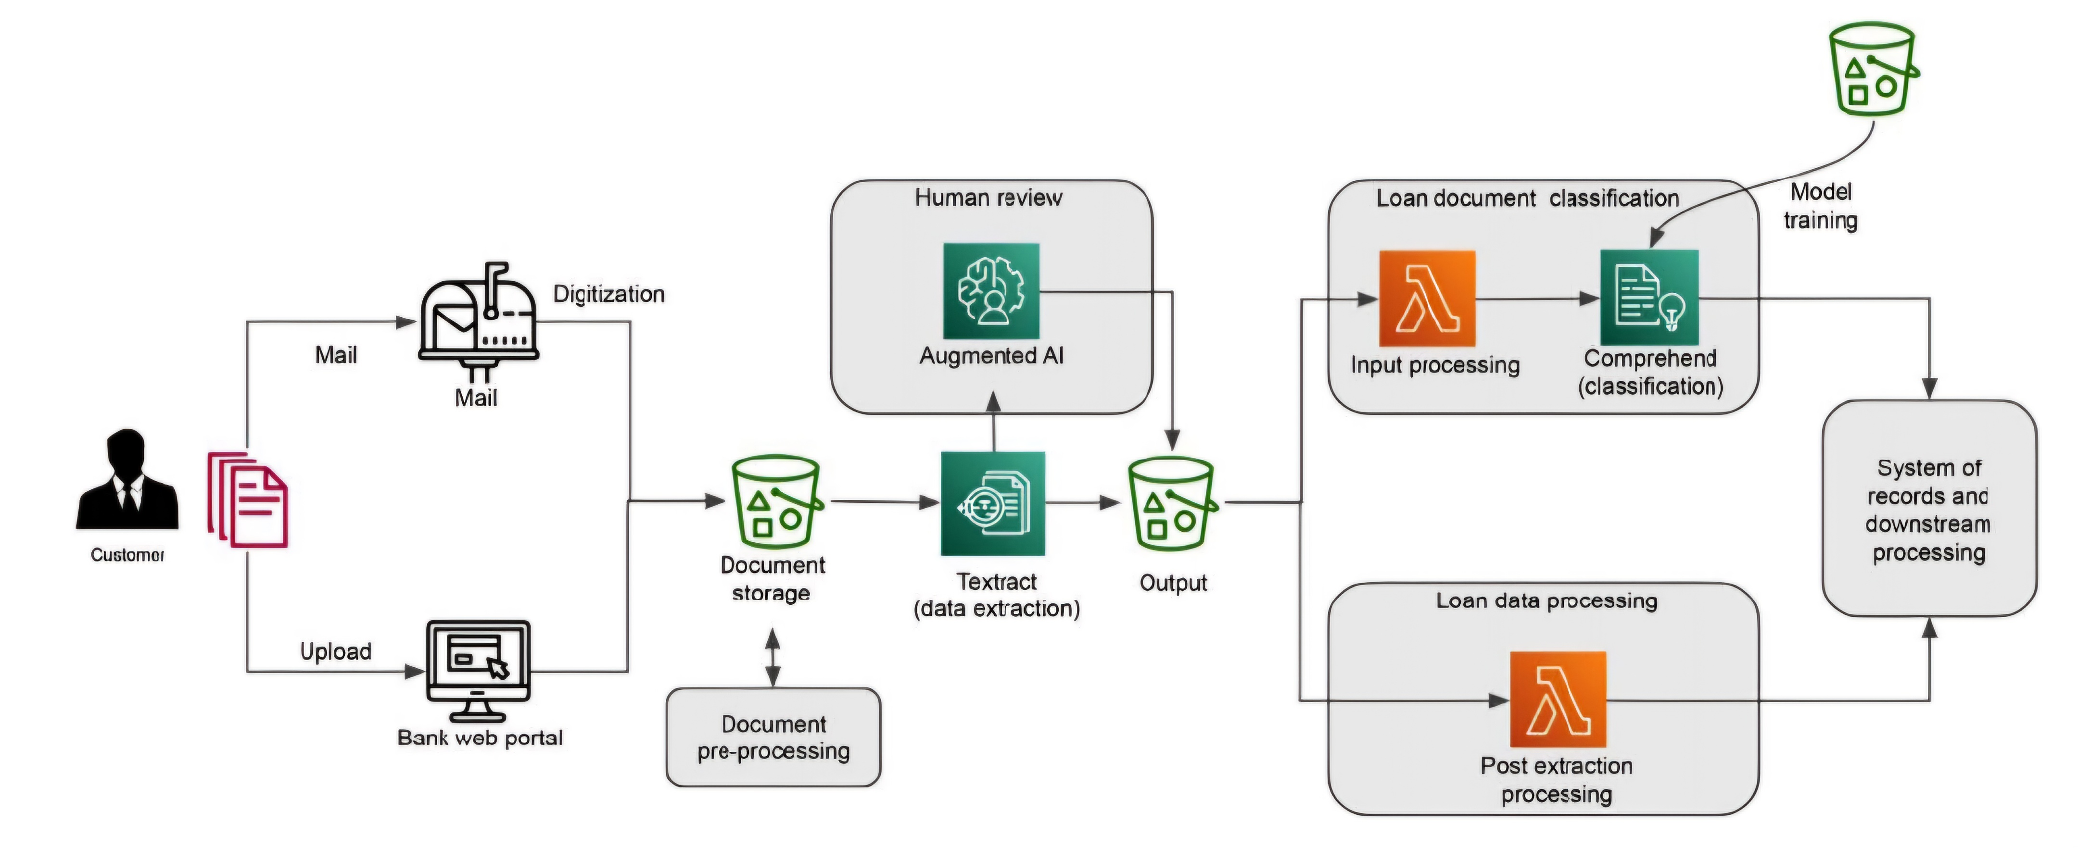
The loan document verification and data extraction process

Slide 6
Amazon Textract – OCR and Document Analysis
OCR for Text Extraction: Extracts text from images and PDFs, with hierarchical data structure.
Table and Form Extraction: Extracts data in tables and key-value pairs, maintaining document relationships.
Signature and Query Detection: Identifies signatures and allows custom queries for targeted data extraction.
Applications: Automated data extraction for insurance, finance, healthcare, and government.

Slide 7
Amazon Rekognition – Image and Video Analysis
Object and Label Detection: Recognizes objects, activities, and scenes with bounding boxes for positions.
Facial Analysis and Recognition: Detects faces, sentiments, demographics, and matches with a stored index.
Content Moderation: Flags inappropriate content (e.g., violence, nudity) for safe media handling.
Applications: Security, content moderation, digital media metadata tagging.

Slide 8
Amazon Transcribe – Speech-to-Text
Media Transcription: Converts audio to text with punctuation for multiple languages.
Call Analytics: Extracts call details, sentiment, talk time, and issue detection.
Redaction and Toxicity Detection: Removes PII and detects toxic language in transcripts.
Medical Transcription: HIPAA-compliant transcription specifically for healthcare terminology.

Slide 9
Amazon Personalize – Recommendations Engine
User Personalization: Predicts items a user will likely interact with or purchase.
Similar Items and Re-Ranking: Finds related items and optimizes item ranking for personalized results.
Required Data: User-item interaction history, optional user and item datasets.
Applications: E-commerce, media content, and financial product recommendations.

Slide 10
Amazon Lex V2 – Conversational AI
Bot Creation for Voice/Text: Automates conversations for tasks like customer service.
Key Concepts: Bots, intents (actions), slots (parameters), and aliases for version management.
AWS Lambda Integration: Executes functions to retrieve user-specific information during conversations.
Applications: Customer support, sales automation, and IT helpdesks.

Slide 11
Amazon Kendra – Intelligent Search
Natural Language Search: Allows users to ask questions and get direct answers instead of keyword search.
Document Ranking and FAQ Matching: Returns semantically relevant documents and matches FAQs.
Index and Data Sources: Generates searchable indexes from structured and unstructured data sources.
Applications: Enterprise information search, knowledge management, and customer service support.

Slide 12
Amazon Q – Generative AI Assistant
Purpose: Provides AI-powered assistance for business, developer, and BI tasks.
Customized Q Variants: Q for business, builders, QuickSight, and Connect (contact center).
Business Use: Helps users find insights, perform tasks, and access information with controlled access.

Slide 13
Evaluating AWS AI Services for Business Use
Functional Fit: Ensures AI service features align with the ML tasks needed (e.g., entity detection, object recognition).
Performance Testing with Custom Data: Tests pre-trained models with company data for accuracy.
API Latency and Throughput: Assesses if service response times meet application requirements.
Cost Analysis: Weighs cost vs. operational efficiency compared to building custom models.

Slide 14
Building Intelligent Solutions with AI Services
Identifying Use Cases: Define business needs and determine if AI services meet both functional and non-functional requirements.
Solution Categories: Common solutions include document processing, media tagging, recommendations, and customer self-service.
Workflow Integration: Combine AI services within business applications for end-to-end automation.

Slide 15
Automated Document Verification and Extraction
Use Case: Loan application processing; banks verify and extract data from documents.
Solution Workflow: Textract extracts data → Comprehend classifies documents → Amazon Augmented AI for human review.
Benefits: Reduces manual workload, speeds up application processing, minimizes human errors.

Slide 16
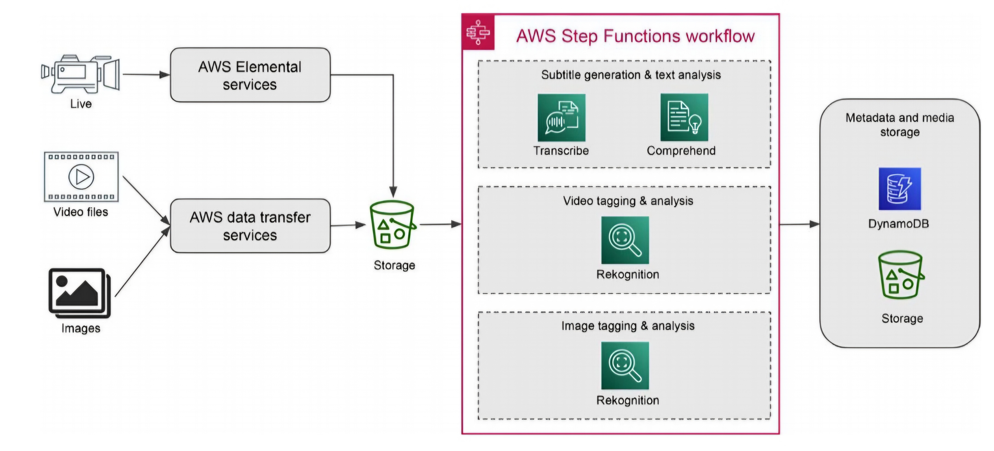
Media tagging and analysis architecture

Slide 17
Media Processing and Analysis Architecture
Problem: Enrich media content with metadata for search and monetization.
Solution Workflow: Transcribe converts audio to text → Comprehend for text analysis → Rekognition tags images/videos.
Applications: Subtitle generation, content recommendations, and digital media search.

Slide 18
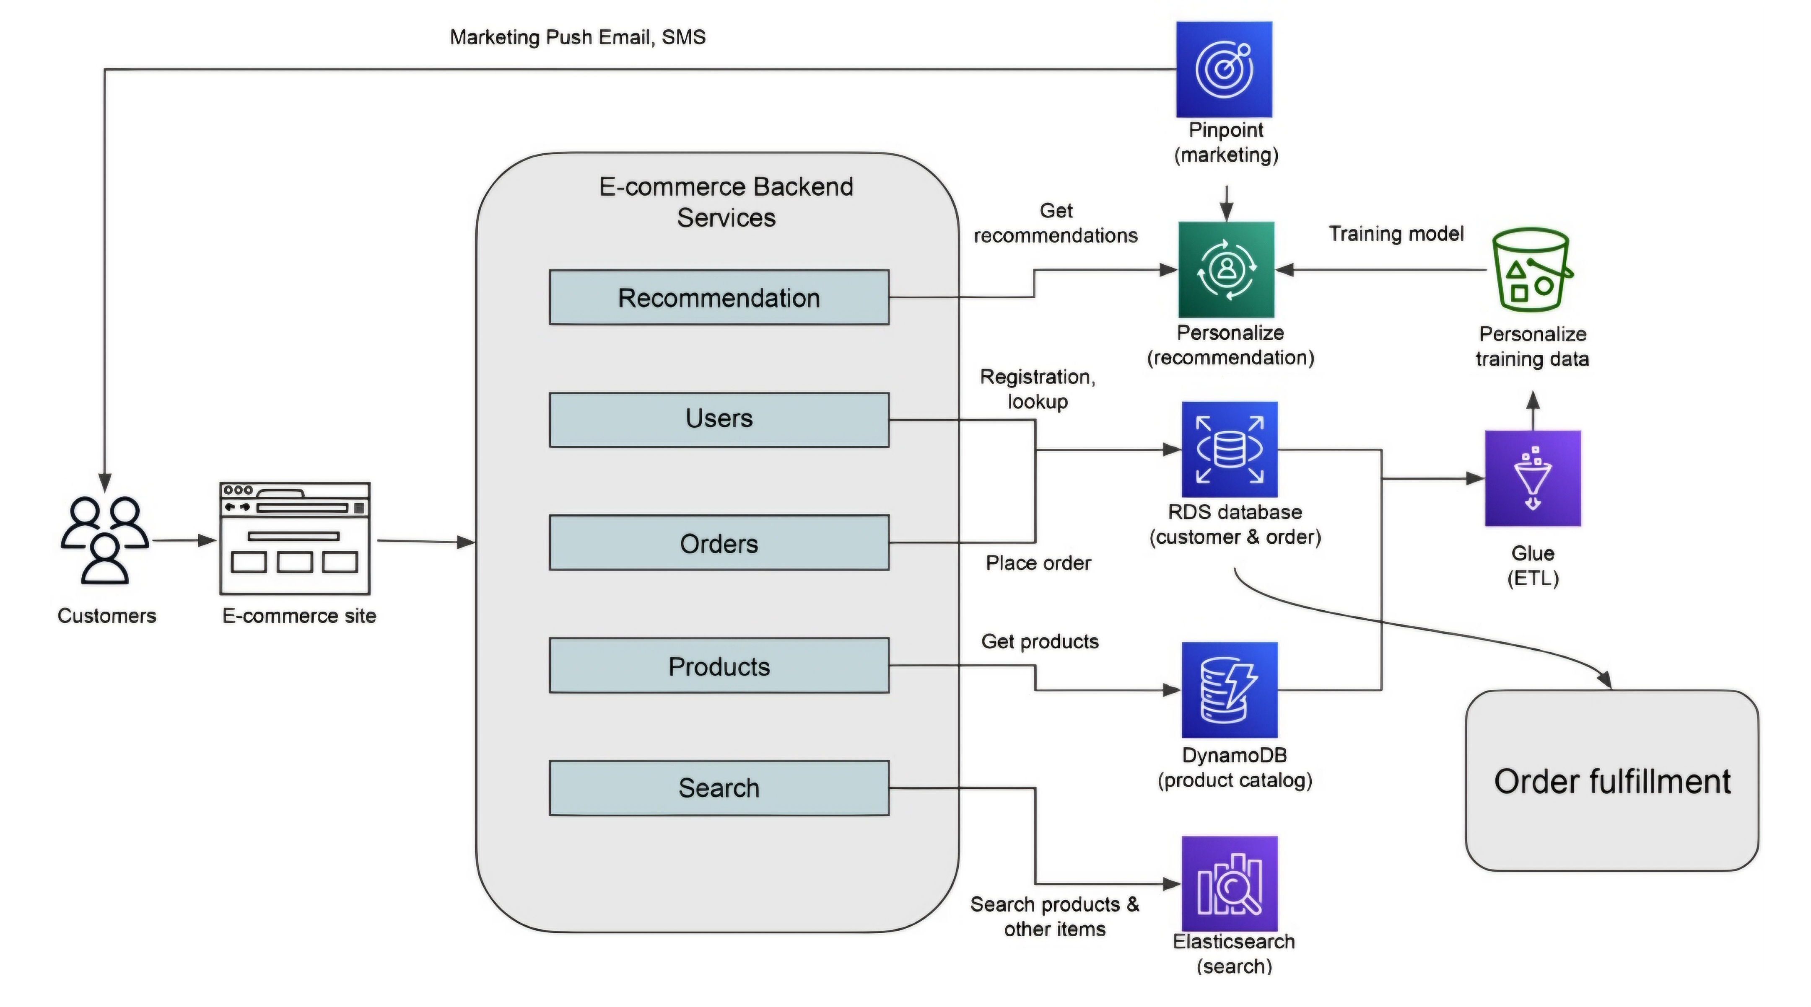
E-commerce site and recommendation architecture

Slide 19
E-commerce Product Recommendations
Objective: Increase customer engagement and sales with tailored product recommendations.
Solution Workflow: Personalize analyzes user interaction history to provide real-time recommendations.
Additional Marketing: Integrates with Amazon Pinpoint for targeted email/SMS campaigns.
Benefits: Enhances user experience and customer loyalty with personalized content.

Slide 20
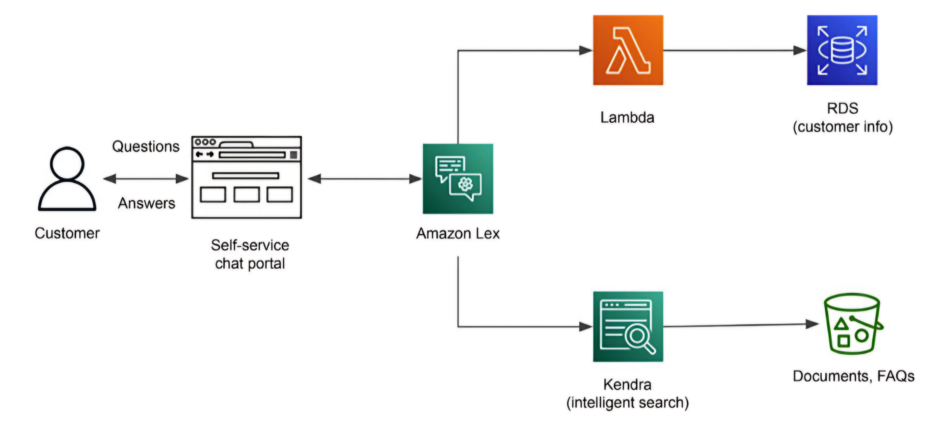
Self-service chat portal with an intelligent virtual assistant

Slide 21
Customer Self-Service with Intelligent Search
Goal: Improve customer satisfaction and reduce support load with self-service options.
Solution Workflow: Lex V2 for conversation → Kendra for knowledge search → Lambda for backend data retrieval.
Application Scenarios: Banking inquiries, FAQ lookups, account information updates.
Benefits: Faster issue resolution, enhanced customer satisfaction, and efficient support management.

Slide 22
MLOps for AI Services – Introduction
What is MLOps for AI Services? Process and tooling to manage AI service model updates, versioning, and deployment.
Benefits: Consistent deployment, scalable operations, improved auditability.
Key Components: CI/CD tools, multi-environment workflows, monitoring metrics.

Slide 23
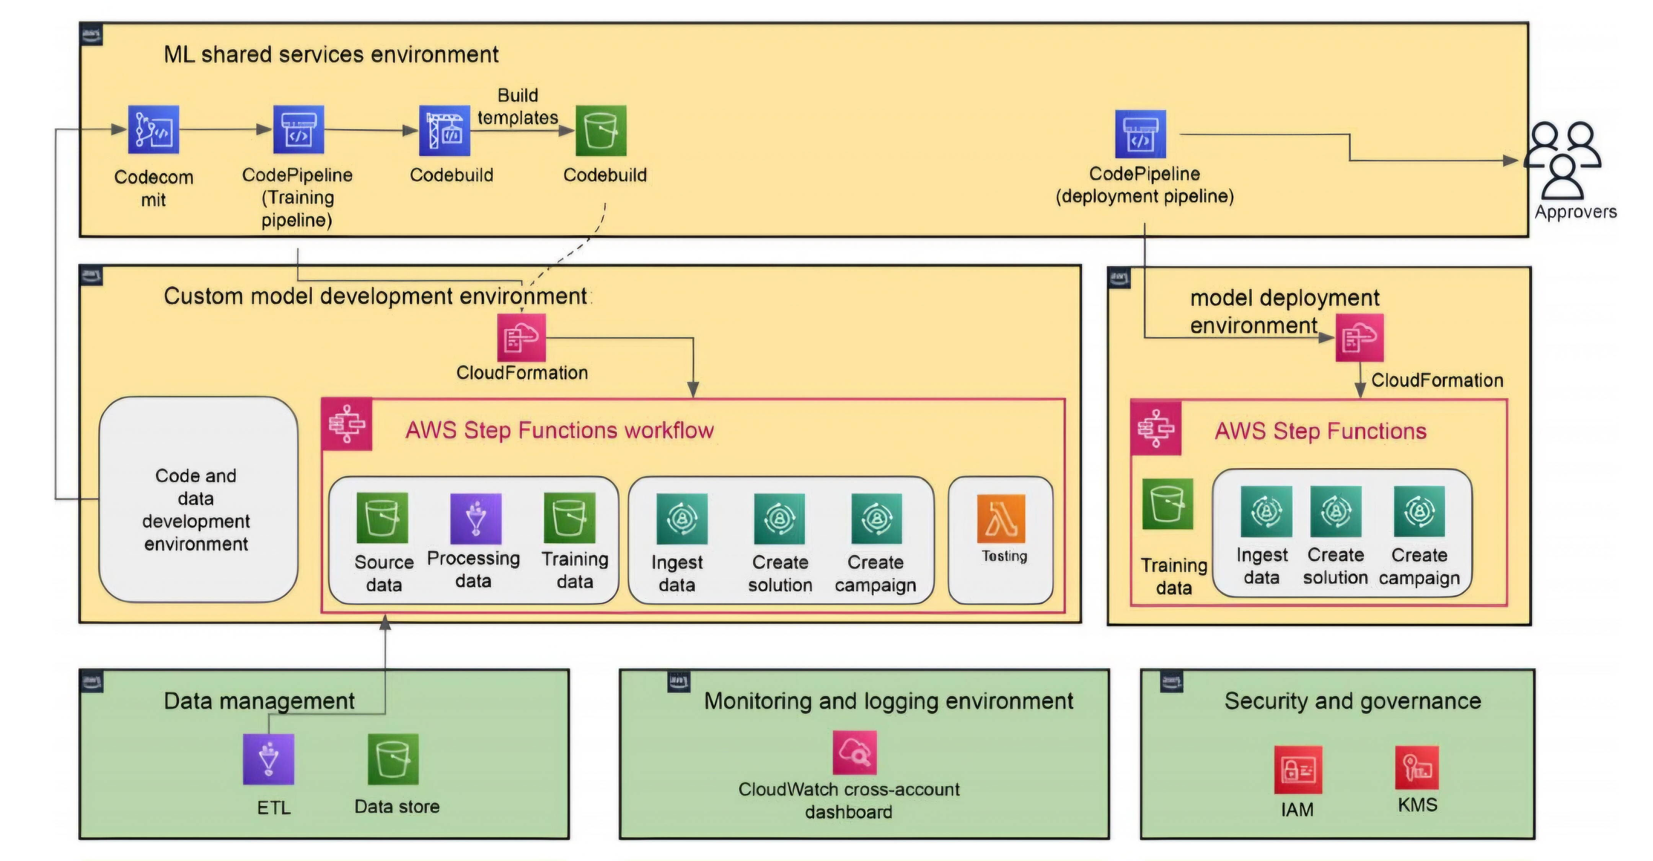
MLOps architecture for AI services on AWS

Slide 24
AWS Account Setup for MLOps
Multi-Account Strategy: Isolates development, testing, and production environments.
Environment Breakdown: Dev for testing pipelines, model development for formal training, production for deployment.
Shared Services: Hosts CI/CD tools like CodePipeline and CodeBuild for consistent deployment across environments.

Slide 25
Code Promotion in MLOps
Code Repository for Promotion: Tracks changes, enabling promotion through development, UAT, and production.
Triggering CodePipeline Jobs: Promotes code from dev to production environments with defined checks.
Automation: Streamlined model training, testing, and deployment with CodePipeline and Step Functions.

Slide 26
Monitoring Metrics in MLOps
Metrics Collection with CloudWatch: Tracks API requests, errors, and latencies for each AI service.
EventBridge Integration: Automates responses based on thresholds (e.g., throttling alerts, error notifications).
Sample Architecture: CloudWatch → Lambda for actions, EventBridge for triggering workflows.

Slide 27
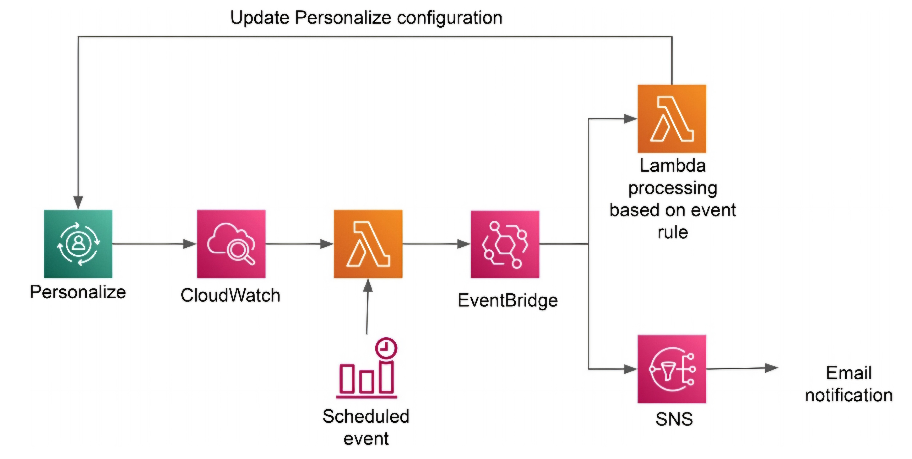
Monitoring architecture for Amazon Personalize

Slide 28
Summary and Key Takeaways
AI Services Recap: Covering NLP, computer vision, recommendations, and conversational AI for various business needs.
Key Benefits: Speed, scalability, reduced ML skill requirements, but with customization limits.
MLOps for AI Services: Ensures scalable, consistent deployments, monitoring, and management.
Encouragement for Exploration: Evaluate AWS AI services for different business scenarios.

